Slide 1
Budget Committee Report
January 2016
John Lloyd, Chair Budget Committee

Slide 2
2015-16 University Budget Overview
Originally scheduled for fall, postponed.
In attendance: President Coley, CFO Quillian, D. Labordo, M. Lopez.
Main takeaways:
President and CFO are optimistic about CPP overall.
CPP is in better shape financially than many other CSUs.
However, CSU has a structural financial issue--and that means CPP too.
President continues close scrutiny of Campus budget "in the weeds."

Slide 3
CSU structural deficit
Since 2008, CSU budget appropriations were cut by approx. $1B (out of approx. $6B total budget).
State legislature has replaced approx. $600M of the reduction, but CSU is educating more students than we were in 2008.
No tuition increases are a condition of Governor's modest budget increases.
Reserves have been used since 2008 to avoid massive layoffs, class cuts.
BoT requested, and Gov. funded reasonable increase, but not sufficient to meet all our operational needs.
Backlog of equipment, deferred maintenance, and construction.
Campuses now responsible for funding new construction out of operating budget (PPP?).

Slide 4
Campus Budget 2015-16
Base budget $268M (up from $251M 2014-15).
Sources:
$121.5M General Fund
$121.5M Tuition Fees
$ 7.8M Non-resident tuition
$ 17.1M Other Fees
Non-Recurring (one time) budget: $54.9M
Total Operating Budget: $322.9M

Slide 5
 | Base Budget | Non-Recurring | Total
Divisions | $150.1M | $22.4M | $172.5M
Centrally Managed | $113.1M | $2.4M | $115.5M
Benefits | $65.8M | $394,088 | $66.2M
Financial Aid | $32.1M | $1.5M | $33.5M
Risk Mgmt | $3.9M | $0.5M | $ 4.4M
Space Rental | $872,900 |  | $872,900
Utilities | $10.4M | $29,331 | $10.43M
University | $4.8M | $30M | $34.8M
Designated | $2.2M | $13.3M ($5M SC) | $15.5M
Unallocated | $573,645 | $9.9M | $10.5M
Benefits Reserve |  | $3.9M | $3.9M
Campus Reserve | $2.0M | $3.0M | $5.0M
Total CPP | $268M | $54.9M | $322.9M

Slide 6
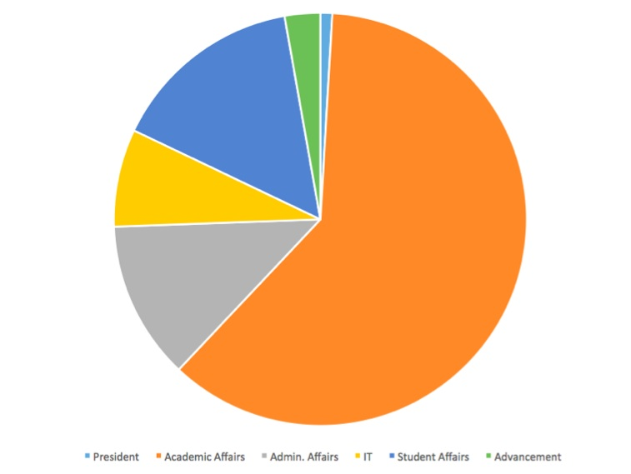
Division Budgets
President $1.6M ($1.5M base)
Academic Affairs $105.4M ($93M)
Admin. Affairs $21.4M ($16.4M)
IT $13.2M ($12.6M)
Student Affairs $26.1M ($22.9M)
Advancement $4.8M ($3.7M)

